Slide 1

Chapter 6
Inputs and
Production Functions

Slide 2

Chapter Six Overview
Motivation
The Production Function
Marginal and Average Products
Isoquants
The Marginal Rate of Technical Substitution
Technical Progress
Returns to Scale
Some Special Functional Forms
Chapter Six

Slide 3
Production of Semiconductor Chips
“Fabs” cost $1 to $2 billion to construct and are obsolete in 3 to 5 years
Must get fab design “right”
Choice: Robots or Humans?
Up-front investment in robotics vs. better chip yields and lower labor costs?
Capital-intensive or labor-intensive production process?
Chapter Six

Slide 4
Key Concepts
Productive resources, such as labor and capital equipment, that firms use to manufacture goods and services are called inputs or factors of production.
The amount of goods and services produces by the firm is the firm’s output.
Production transforms a set of inputs into a set of outputs
Technology determines the quantity of output that is feasible to attain for a given set of inputs.
Chapter Six

Slide 5
Key Concepts
The production function tells us the maximum possible output that can be attained by the firm for any given quantity of inputs.
Production Function:
Q = output
K = Capital
L = Labor
The production set is a set of technically feasible combinations of inputs and outputs.
Chapter Six

Slide 6
The Production Function & Technical Efficiency
Q
Production Function
Q = f(L)
D
•
C
•
•
B
•
Production Set
A
L
Chapter Six

Slide 7
The Production Function & Technical Efficiency
Technically efficient: Sets of points in the production function that maximizes output given input (labor)
Technically inefficient: Sets of points that produces less output than possible for a given set of input (labor)
Chapter Six

Slide 8
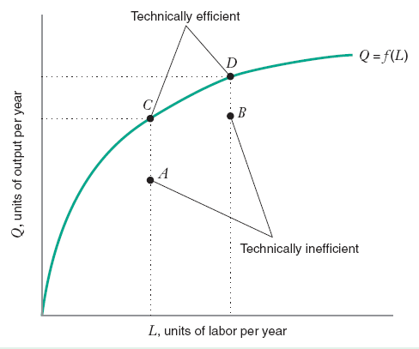
The Production Function & Technical Efficiency
Chapter Six

Slide 9
Labor Requirements Function
Labor requirements function
for production function - you would have:
Chapter Six

Slide 10
The Production & Utility Functions
Chapter Six

Slide 11
The Production & Utility Functions
Chapter Six

Slide 12
The Production Function & Technical Efficiency
Chapter Six

Slide 13
Total Product
Total Product Function: A single-input production function. It shows how total output depends on the level of the input
Increasing Marginal Returns to Labor: An increase in the quantity of labor increases total output at an increasing rate.
Diminishing Marginal Returns to Labor: An increase in the quantity of labor increases total output but at a decreasing rate.
Diminishing Total Returns to Labor: An increase in the quantity of labor decreases total output.
Chapter Six

Slide 14
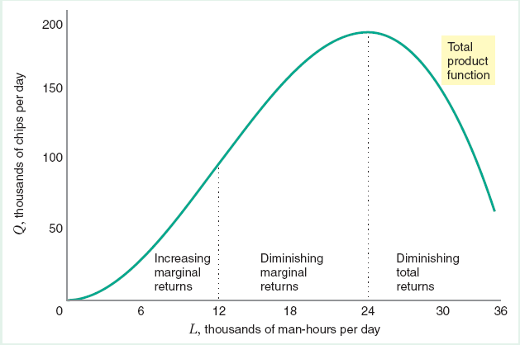
Total Product
Chapter Six

Slide 15
The Marginal Product
Definition: The marginal product of an input is the change in output that results from a small change in an input holding the levels of all other inputs constant.
MP_{L} = ΔQ/ΔL
(holding constant all other inputs)
MP_{K} = ΔQ/ΔK
(holding constant all other inputs)
Example: Q = K^{1/2}L^{1/2}
MP_{L} = (1/2)L^{-1/2}K^{1/2}
MP_{K} = (1/2)K^{-1/2}L^{1/2}
Chapter Six

Slide 16
The Average Product & Diminishing Returns
Definition: The average product of an input is equal to the total output that is to be produced divided by the quantity of the input that is used in its production:
AP_{L} = Q/L
AP_{K} = Q/K
Example:
AP_{L} = [K^{1/2}L^{1/2}]/L = K^{1/2}L^{-1/2}
AP_{K} = [K^{1/2}L^{1/2}]/K = L^{1/2}K^{-1/2}
Definition: The law of diminishing marginal returns states that marginal products (eventually) decline as the quantity used of a single input increases.
Chapter Six

Slide 17
Total, Average, and Marginal Products
L | Q | APL | MPL
6 | 30 | 5 | -
12 | 96 | 8 | 11
18 | 162 | 9 | 11
24 | 192 | 8 | 5
30 | 150 | 5 | -7
Chapter Six

Slide 18
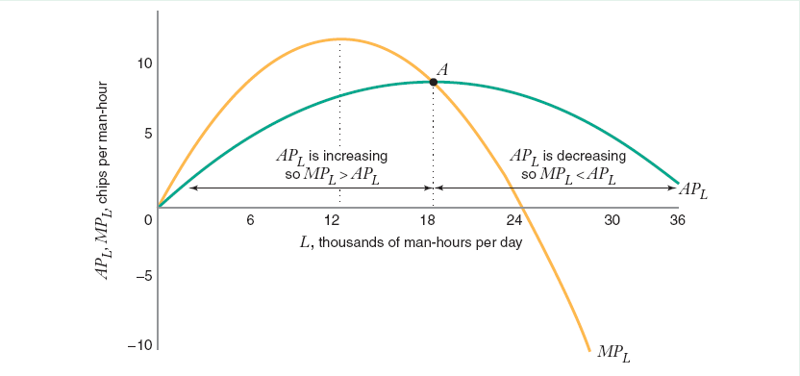
Average, and Marginal Products (goes with p 14)
Chapter Six

Slide 19
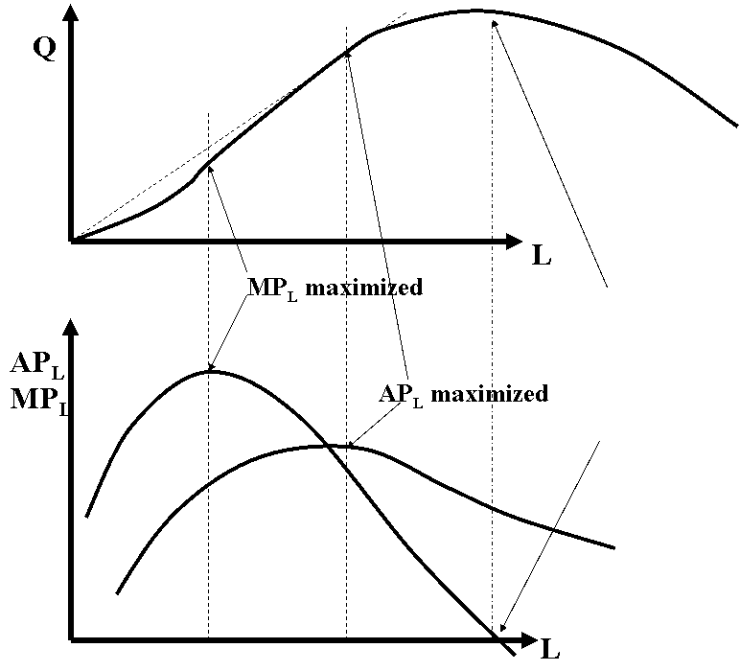
Total, Average, and Marginal Magnitudes
TP_{L} maximized where MP_{L} is zero. TP_{L} falls where MP_{L} is negative; TP_{L} rises where MP_{L} is positive.
Chapter Six

Slide 20
Production Functions with 2 Inputs
Marginal product: Change in total product holding other inputs fixed.
Chapter Six

Slide 21
Isoquants
Definition: An isoquant traces out all the combinations of inputs (labor and capital) that allow that firm to produce the same quantity of output
And…
Chapter Six

Slide 22
Isoquants
Chapter Six

Slide 23
Isoquants
K
All combinations of (L,K) along the
isoquant produce 20 units of output.
Example:
Q = 20
Slope=ΔK/ΔL
Q = 10
L
0
Chapter Six

Slide 24
Marginal Rate of Technical Substitution
Definition: The marginal rate of technical substitution measures the amount of an input, L, the firm would require in exchange for using a little less of another input, K, in order to just be able to produce the same output as before.
MRTS_{L,K} = -ΔK/ΔL (for a constant level of output)
Marginal products and the MRTS are related:
MP_{L}(ΔL) + MP_{K}(ΔK) = 0
=> MP_{L}/MP_{K} = -ΔK/ΔL = MRTS_{L,K}
Chapter Six

Slide 25
Marginal Rate of Technical Substitution
The rate at which the quantity of capital that can be decreased for every unit of increase in the quantity of labor, holding the quantity of output constant,
Or
The rate at which the quantity of capital that can be increased for every unit of decrease in the quantity of labor, holding the quantity of output constant
Therefore
Chapter Six

Slide 26
Marginal Rate of Technical Substitution
If both marginal products are positive, the slope of the isoquant is negative.
If we have diminishing marginal returns, we also have a diminishing marginal rate of technical substitution - the marginal rate of technical substitution of labor for capital diminishes as the quantity of labor increases, along an isoquant – isoquants are convex to the origin.
For many production functions, marginal products eventually become negative. Why don't most graphs of Isoquants include the upwards-sloping portion?
Chapter Six

Slide 27
Isoquants
Isoquants
K
MP_{K} < 0
Example: The Economic and the Uneconomic Regions of Production
Q = 20
MP_{L} < 0
Q = 10
L
0
Chapter Six

Slide 28
Marginal Rate of Technical Substitution
Chapter Six

Slide 29
Elasticity of Substitution
A measure of how easy is it for a firm to substitute labor for capital.
It is the percentage change in the capital-labor ratio for every one percent change in the MRTS_{L,K} along an isoquant.
Chapter Six

Slide 30
Elasticity of Substitution
Definition: The elasticity of substitution, σ, measures how the capital-labor ratio, K/L, changes relative to the change in the MRTS_{L,K}.
Chapter Six

Slide 31
Elasticity of Substitution
Example: Suppose that:
MRTS_{L,K}^{A} = 4, K^{A}/L^{A} = 4
MRTS_{L,K}^{B} = 1, K^{B}/L^{B} = 1
ΔMRTS_{L,K} = MRTS_{L,K}^{B} - MRTS_{L,K}^{A} = -3
σ = [Δ(K/L)/ΔMRTS_{L,K}]*[MRTS_{L,K}/(K/L)] = (-3/-3)(4/4) = 1
Chapter Six

Slide 32
Elasticity of Substitution
K
"The shape of the isoquant indicates the degree of substitutability of the inputs…"
σ = 0
σ = 1
σ = 5
σ = ∞
L
0
Chapter Six

Slide 33
Returns to Scale
How much will output increase when ALL inputs increase by a particular amount?
Chapter Six

Slide 34
Returns to Scale
Let λ represent the amount by which both inputs, labor and capital, increase.
Let Φ represent the resulting proportionate increase in output, Q
Increasing returns:
Decreasing returns:
Constant Returns:
Chapter Six

Slide 35
Returns to Scale
How much will output increase when ALL inputs increase by a particular amount?
RTS = [%ΔQ]/[%Δ (all inputs)]
If a 1% increase in all inputs results in a greater than 1% increase in output, then the production function exhibits increasing returns to scale.
If a 1% increase in all inputs results in exactly a 1% increase in output, then the production function exhibits constant returns to scale.
If a 1% increase in all inputs results in a less than 1% increase in output, then the production function exhibits decreasing returns to scale.
Chapter Six

Slide 36
Returns to Scale
K
2K
Q = Q₁
K
Q = Q₀
L
0
L 2L
Chapter Six

Slide 37
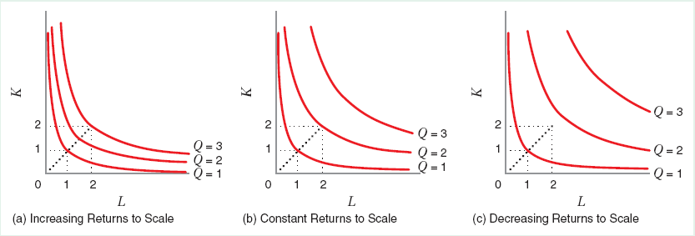
Returns to Scale
Chapter Six

Slide 38
Returns to Scale vs. Marginal Returns
Returns to scale: all inputs are increased simultaneously
Marginal Returns: Increase in the quantity of a single input holding all others constant.
• The marginal product of a single factor may diminish while the returns to scale do not
• Returns to scale need not be the same at different levels of production
Chapter Six

Slide 39
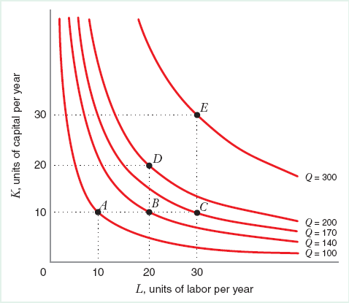
Returns to Scale vs. Marginal Returns
Production function with CRTS but diminishing marginal returns to labor.
Chapter Six

Slide 40
Technological Progress
Definition: Technological progress (or invention) shifts the production function by allowing the firm to achieve more output from a given combination of inputs (or the same output with fewer inputs).
Chapter Six

Slide 41
Technological Progress
Labor saving technological progress results in a fall in the MRTS_{L,K} along any ray from the origin
Capital saving technological progress results in a rise in the MRTS_{L,K} along any ray from the origin.
Chapter Six

Slide 42
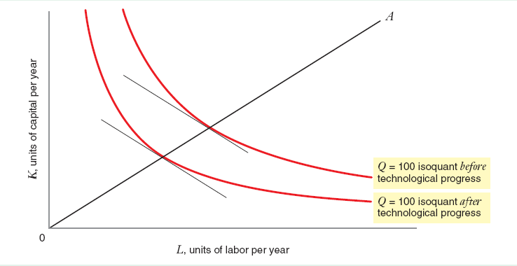
Neutral Technological Progress
Technological progress that decreases the amounts of labor and capital needed to produce a given output. Affects MRTS_{K,L}
Chapter Six

Slide 43
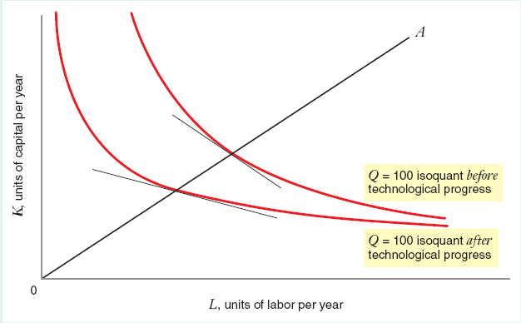
Labor Saving Technological Progress
Technological progress that causes the marginal product of capital to increase relative to the marginal product of labor
Chapter Six

Slide 44
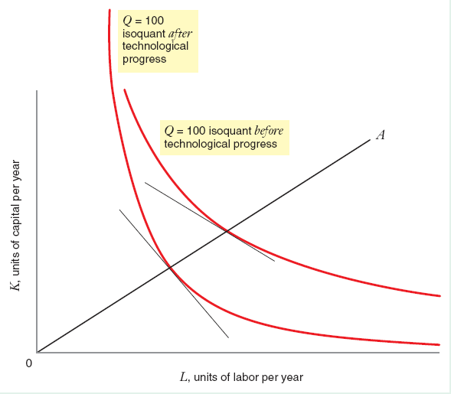
Capital Saving Technological Progress
Technological progress that causes the marginal product of labor to increase relative to the marginal product of capital
Chapter Six

